Slide 1
Deforestation Data Platform
A Power BI Dashboard for Tracking Global Deforestation Trends
By, Bhargav Taraviya &
Trupal Ukani

Slide 2
Contents
UN Sustainable Development Goals (SDGs)
Project Status
Demo
Research Paper Progress

Slide 3
UN Sustainable Development Goals (SDGs)
SDG 15: Life on Land – Protecting forests and biodiversity.
SDG 13: Climate Action
Goal: Sustainably manage forests, halt biodiversity loss
Our Contribution: Help users understand forest loss drivers and trend
Goal: Take urgent action to combat climate change and its impacts
Our Contribution: Raise awareness and visualize tree loss over time
Notes:
Our project directly supports two SDGs. SDG 13 emphasizes climate action—something we address by visualizing how deforestation contributes to emissions. SDG 15 is about protecting life on land, which we tackle by making data about forest loss and its causes more understandable to the public.

Slide 4
Existing Platforms & Communities
Digital Tools for SDG 13 & 15: What's Out There?
Global Forest Watch (GFW): Real-time monitoring, satellite data
FAO Forest Resources: Global forest stats, PDF reports
GIS Tools (e.g., ArcGIS): Professional, spatial analytics
Notes:
These are powerful platforms, but they’re mostly built for experts. While useful for research and governance, they’re not accessible for students or the general public.

Slide 5
Community Orientation & Gaps
Our Audience & the Gap We Identified
🎯 Target Users:
Middle school students
Educators
Non-technical public
🧩 Gaps in Existing Tools:
Too complex (GIS)
Low interactivity
Not education-focused
Notes:
We focused on designing for education and awareness. During our research, we found that students want visual learning tools and teachers want resources for classroom engagement.

Slide 6
Our Innovation
What Makes Our Platform Unique
📊 Built with Power BI for simplicity and visual learning
🧠 Combines:
Tree loss
Deforestation causes
Regional comparison
🧭 Interactive: filters, tooltips, drill-throughs
🎓 Education-first, not analysis-first
Notes:
Our platform doesn’t compete with GFW(global forest watch)—it complements it by making the data usable for the everyday learner. We filled the accessibility and education gap that’s missing in other tools.

Slide 7
Why We Built This
🌍 Deforestation is a major driver of climate change (SDG 13) and biodiversity loss (SDG 15)
📉 Data is often hard to interpret for non-experts
🎓 Students and educators need accessible tools for environmental literacy
Notes:
We saw an opportunity to bridge the gap between global deforestation data and public understanding. Our ‘why’ was simple: empower people to understand environmental issues through data that speaks their language—visual, clear, and interactive.

Slide 8
How We Built It
From Concept to Platform: Our Approach
🧠 Community-driven design
🔄 Iterative development with user testing
🎯 Focus: Simple UI + high interactivity
Methodology:
Used concepts from user-centered design, CoP research, and ethical tech development (from lectures)
Applied design thinking to align with real needs
Notes:
Our process was shaped by what we learned in class—especially around building for community impact. We emphasized iterative testing, feedback, and keeping the user experience central to every design decision.

Slide 9
What We Built (Demo Overview)
The Deforestation Data Platform (Demo Highlights)
🗺️ Tree Cover Loss View: Global loss trends over time
🌎 Regional Comparison Tool: Filter by continent/country
🧱 Deforestation Drivers View: Causes like logging, agriculture
🧭 Interactive Features:
Time-based filters
Drill-throughs for detail
Tooltips & info cards
Notes:
The platform is fully interactive. Users can explore global trends, zoom into countries, or see how agriculture vs. logging is affecting forests. It’s all about learning by exploring.

Slide 10
🌲🌿 It's Demo Time! 🌿🌲

Slide 11
Technical Stack & Architecture
Content:
⚙️ Frontend & Visualization: Microsoft Power BI
📊 Data Transformation: Excel + Power Query
📈 Metrics & Logic: DAX (Data Analysis Expressions)
🗃️ Datasets:
Global Forest Watch (tree cover, causes)
FAO datasets (historical data)
Architecture:
Cleaned data in Excel/Power Query
Loaded into Power BI
Visualized using slicers, maps, and dynamic charts
Drill-through navigation for deep exploration
Notes:
Power BI allowed us to quickly build a flexible, visually rich dashboard. DAX gave us custom metrics like percent change over time and forest loss by region

Slide 12
Technical Pros & Cons
Development Experience: Pros & Challenges
Pros:
✅ Fast prototyping with Power BI
✅ Powerful visual storytelling tools
✅ Powerful Data Cleaning tool(Power Query)
✅ Easy sharing and collaboration
Cons:
⚠️ Performance issues with some charts
⚠️ Limited backend flexibility (no custom backend logic for visual)
⚠️ User guidance within the platform still limited (future work)
Notes:
Power BI allowed for fast prototyping, with great visual storytelling and seamless data cleaning using Power Query. It was also easy to share and collaborate.
However, we faced performance issues with complex charts, and Power BI lacks backend customization for custom logic. Also, user guidance is still limited, which is a key area for future work.

Slide 13
Ties to ENSE 805 Learnings
Applying Course Concepts
💡 User-centric design – simplicity and accessibility
🌐 CoPs & digital habitats – designing for non-technical community use
🧠 SDG integration – aligning engineering work with global impact
🧭 Ethical tech planning – focusing on transparency and social good
Notes:
In our project, we applied key concepts from ENSE 805:
User-centric design: Prioritized simplicity and accessibility to ensure the platform is easy for non-experts to use.
CoPs & digital habitats: Focused on designing for community use, allowing broad access and engagement.
SDG integration: Aligned our project with global impact by supporting SDG 13 (Climate Action) and SDG 15 (Life on Land).
Ethical tech planning: Ensured transparency and social good were at the heart of our platform’s development, keeping user empowerment and ethical standards in mind.

Slide 14
Future Work & Reflection
Future Work:
Self/Team Reflection:
Add educational tooltips and explanatory cards for better user guidance
Focus on mobile optimization for broader accessibility
Integrate predictive analytics to forecast deforestation trends
Explore gamification features (quizzes, knowledge tests)
Proud of: Bridging the gap between complex data and public education
Challenges faced: Data performance issues and user guidance limitations
Key Learnings: Importance of community-driven design and adapting to feedback
Going forward: Continue creating accessible solutions with a focus on user feedback

Slide 15
📄 Research Paper Progress 🌱
Current Progress: ✅ Modified the paper according to target audience ✅ Added Literate Review, Conclusion & References ✅ Focused on importance of visual education for target audience
Next Sections in Progress: ➡ Add Result, Future work section and finalize the paper

Slide 16
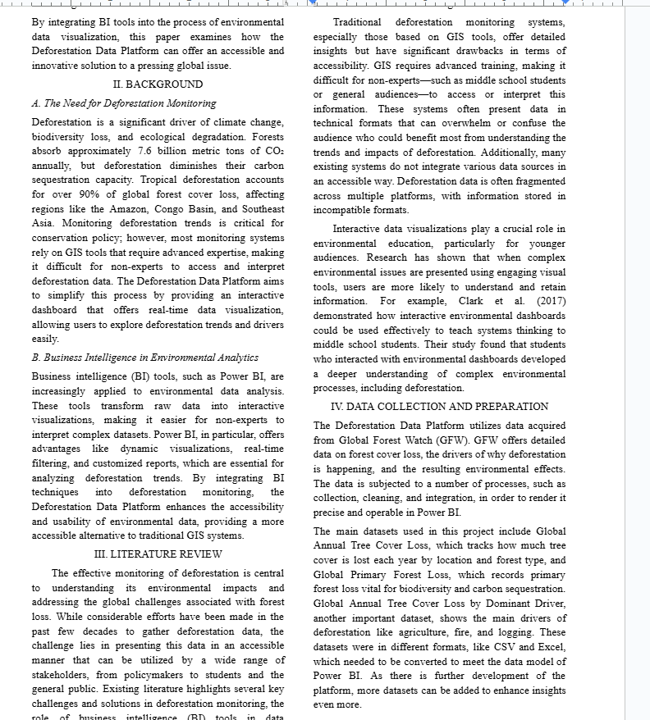
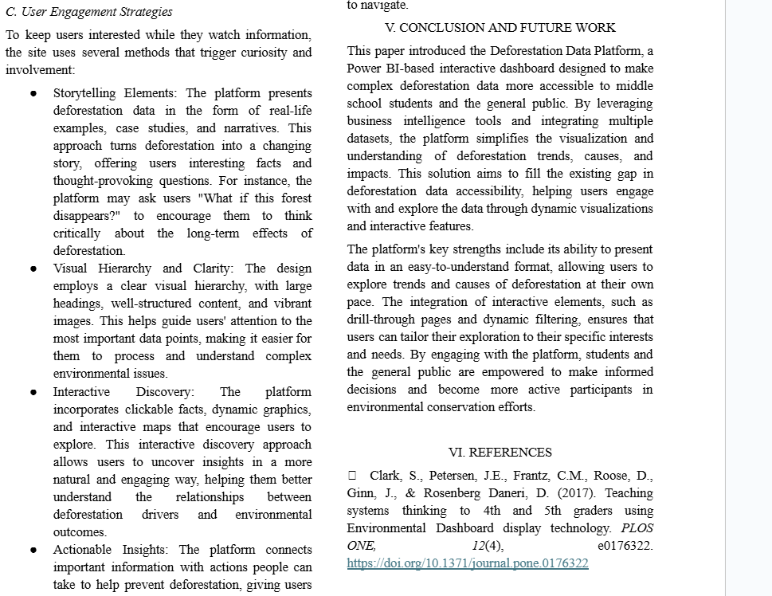

Slide 17
Thank You

